Slide 1
Chapter 9. Limited Dependent Variable models
Financial Econometrics
Department of financial engineering
Zhongnan university of economics and law
Xu Yonghao
2022

Slide 2
oUTLINE
Introduction
Binary Choice Model
Tobit Model
Truncated Regression Model
Reference：Wooldridge, Chap 17；Greene, Chap 17-19

Slide 3
1 Introduction
Question：Whether you attend graduate school?
Binary choice model
Using binary variable to depict whether you attend graduate school; Unlike the OLS case, the y takes from –infinity to + infinity
More complicated cases：
Multinomial Choice: location - Domestic？US? UK?
Multinomial logit model*
Ordinal Choice: Domestic schools - Top2? 985? 211?
Ordinal logit model*

Slide 4
1 Introduction
Multinomial choice: 在哪上市：A股,HK, NASDAQ; 上班交通方式
Multinomial logit model*
Ordinal choice (顺序选择问题): 债券信用评级，融资偏好顺序选择, 分析师评级
Ordinal logit model*
Count data variables：当选三好学生的次数，被处罚的次数
Poisson regression*
Mess distributed sample：公司分红多少（大量公司不分红），家庭股市投资（大量家庭不投)
Tobit model
Truncated sample: 家庭消费行为研究（低消费水平家庭不参加调查）
Truncated regression

Slide 5
2.1 Binary Choice Model - ols
Can we use OLS? Estimating y = b₀ + x b₁ + e
Basic assumptions?
Seems ok using OLS
But how to interpret?
If the Binary/Dummy variable is the dependent variable, it has clear economic meaning in
y = b₀ + x b₁ + e
b₁ represents the difference between two kinds of individuals/subjects

Slide 6
2.1 Binary Choice Model - ols
How to understand the linear model when y is a dummy variable y = b₀ + x b₁ + e
The probability that choosing yes： y=1 yes; y=0 no
Therefore, any y that takes and only takes two different values can be treated as a dummy variable, which equals 1 or 0
The model aims at study how X has an impact on the probability of y
Linear probability model （LPM）： y = b₀ + x b₁ + e ，
Probability(yes|x) = b₀ + x b₁

Slide 7
2.1 Binary Choice Model
Table 1
Y | Attend postgraduate school
X1 | GPA | GPA | GPA
X2 | IQ | IQ | IQ
X3 |  | Female | Female
X4 |  | Age | Age
X5 |  |  | Family Income
X6 |  |  | Sibling
Obs
R2

Slide 8
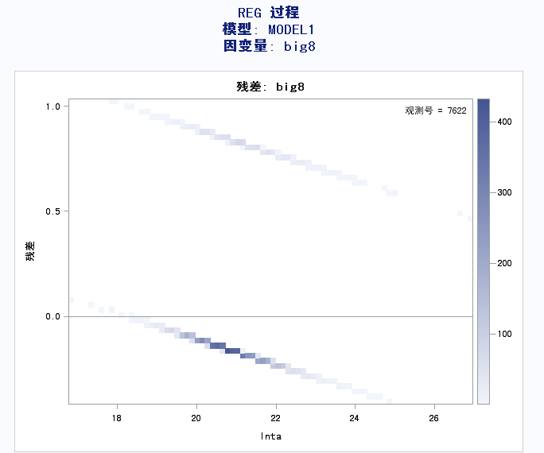
2.1 Binary Choice Model - ols
Problem 1: the fitted value does not only takes from 0 to 1
It contradicts to the definition of probability
Problem 2: heteroscedastic
There is a clear pattern between the residuals and the predicted values
The residuals lie on two linear lines because the values of big8 are either zero or one
To summarize, even though LPM model satisfies classic assumptions and used by researchers, It has two problems:
Not all the predicted values can be interpreted (i.e., they can be negative or greater than one)
The standard errors are biased because the residuals are heteroscedastic.
Therefore, a better model is needed.

Slide 9
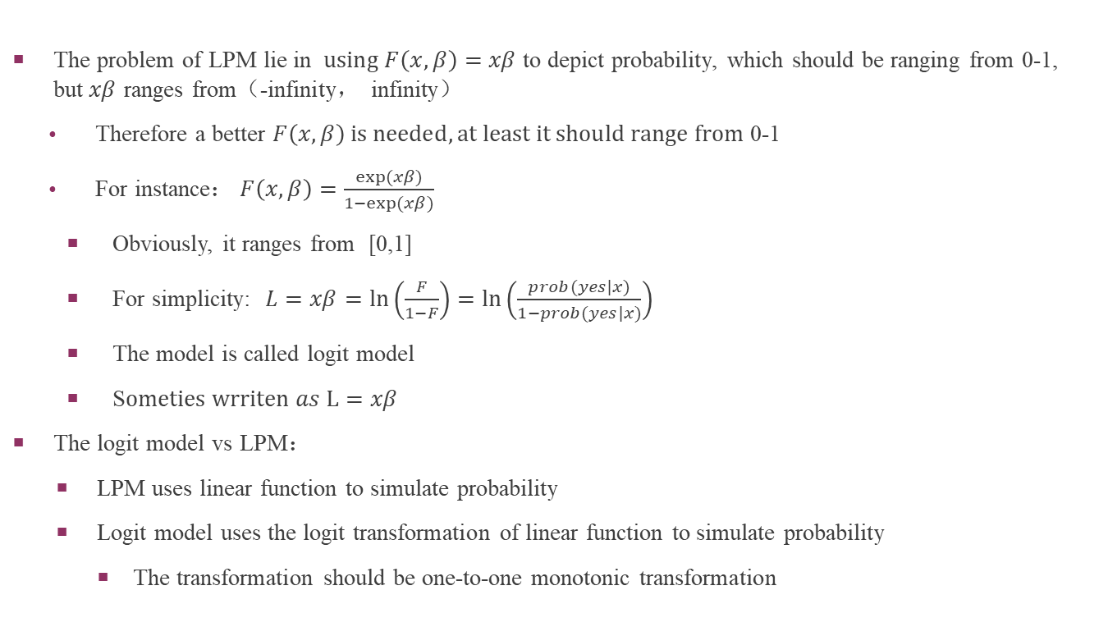
2.2 Binary Choice Model - Logit
The problem of LPM lie in $using F\left(x,β\right)=xβ$ to depict probability, which should be ranging from 0-1, but$xβ$ ranges from（-infinity， infinity）
Therefore a better $F\left(x,β\right) is needed, at least it should range from$ 0-1
For instance$： F\left(x,β\right)=\frac{exp(xβ)}{1−exp(xβ)}$
Obviously, it ranges from [0,1]
For simplicity: $L=xβ=ln\left(\frac{F}{1−F}\right)=ln\left(\frac{prob(yes|x)}{1−prob(yes|x)}\right)$
The model is called logit model
S$ometies wrriten as L=xβ$
The logit model vs LPM：
LPM uses linear function to simulate probability
Logit model uses the logit transformation of linear function to simulate probability
The transformation should be one-to-one monotonic transformation

Slide 10
2.2 Binary Choice Model - Logit
The interpretation of the coefficients for the logit is the same as in OLS
L = a₀+ a₁ X₁ + a₂ X₂
For example when X₁ increases by one unit, the predicted values of the logit，L， increase by a₁
Or we care about the effect of x on P(y = 1|x), that is, we care about ∂p/ ∂x
For the logit models:
∂p/ ∂x_{j} = g(L)b_{j}, where g(L) is dProb/dL
由于g(L) 依赖于x，对概率的边际影响，logit模型中是非线性。
Stata 能计算这个边际影响， 但用得是x的平均值。我们后面再讨论。
For prediction, we care ∂p/ ∂x;
For inference, the coefficients themselves are more simpler.

Slide 11
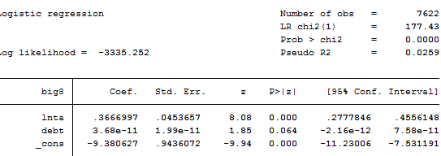
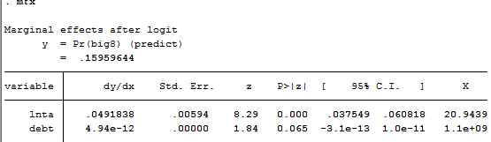
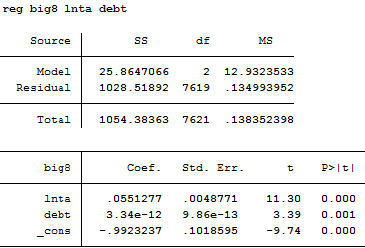
2.2 Binary Choice Model - Logit
Testing significance, asymptotic t test（also called z test ）
Beta: g(L) = dProb/dL
The original beta, 0.367 here is the marginal effect of size on L, not probability.

Slide 12
2.2 Binary Choice Model - Logit
Usually, we are mainly interested in the signs and statistical significance of the coefficients
In logit model using Wald – test or asymptotic t-test
We find that lnta is significant, means that larger companies are significantly more likely to hire big8 auditors.
对多约束的检验，using MLE estimation, we have Wald, LR, LM test.
logit big8 lnta debt
test lnta=debt
(code in stata)

Slide 13
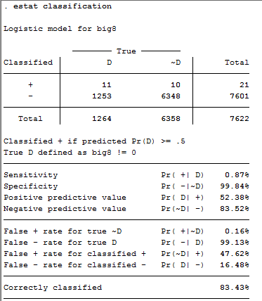
2.2 Binary Choice Model - logit
Unlike the OLS, where we can compute an R² to judge goodness of fit, we need new measures of goodness of fit
One way is to look at the percent correctly predicted – if predict a probability >.5 then that matches y = 1 and vice versa
Example:
logit big8 lnta debt
estat classification

Slide 14
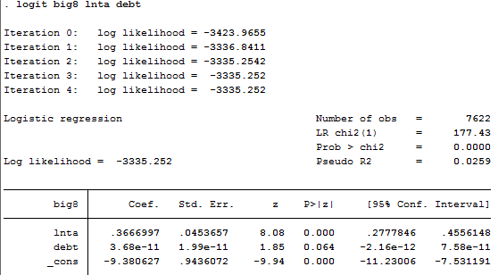
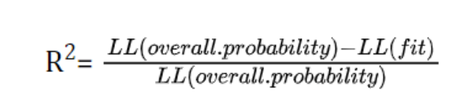
2.2 Binary Choice Model - logit
Another method is the pseudo R2 based on the log likelihood and defined as (Lur-Lr)/|Lr|。 (Maximum Likelihood Estimation )
It is actually the difference between the first and last values of the likelihood function. 0.0259=(3423.9655-3335.252)/3423.9655
The first one is taken when all coefficients of the independent variables being zero
The larger the difference between these two values, the greater the explanatory power of the independent variables in explaining the dependent variable.

Slide 15
2.2 Binary Choice Model - logit
In OLS, we have an F test for R-square, we also have a test for the pseudo-R2
We can use the likelihood-ratio statistic to test the hypothesis that the independent variables have no explanatory power (i.e., all coefficients except the intercept are zero).
The probability that this hypothesis is true is reported in the line “Prob > chi2”. In our example we can reject this hypothesis because the probability is virtually zero.
Just as with OLS, we can use the robust option to correct for any heteroscedasticity and we can use the cluster() option to control for correlated errors
logit big8 lnta
logit big8 lnta, robust
logit big8 lnta, robust cluster(id)

Slide 16
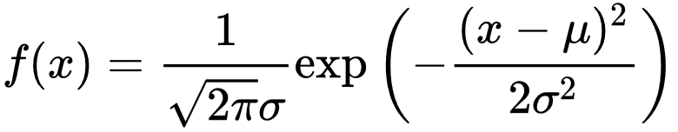
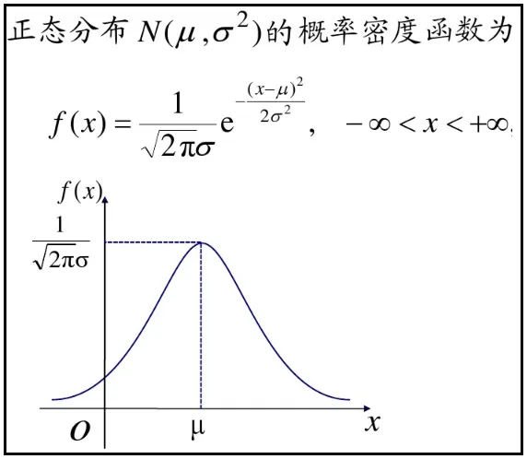
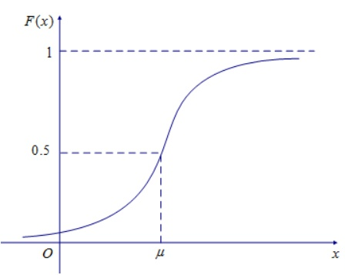
2.3 Binary Choice Model - Probit

Slide 17
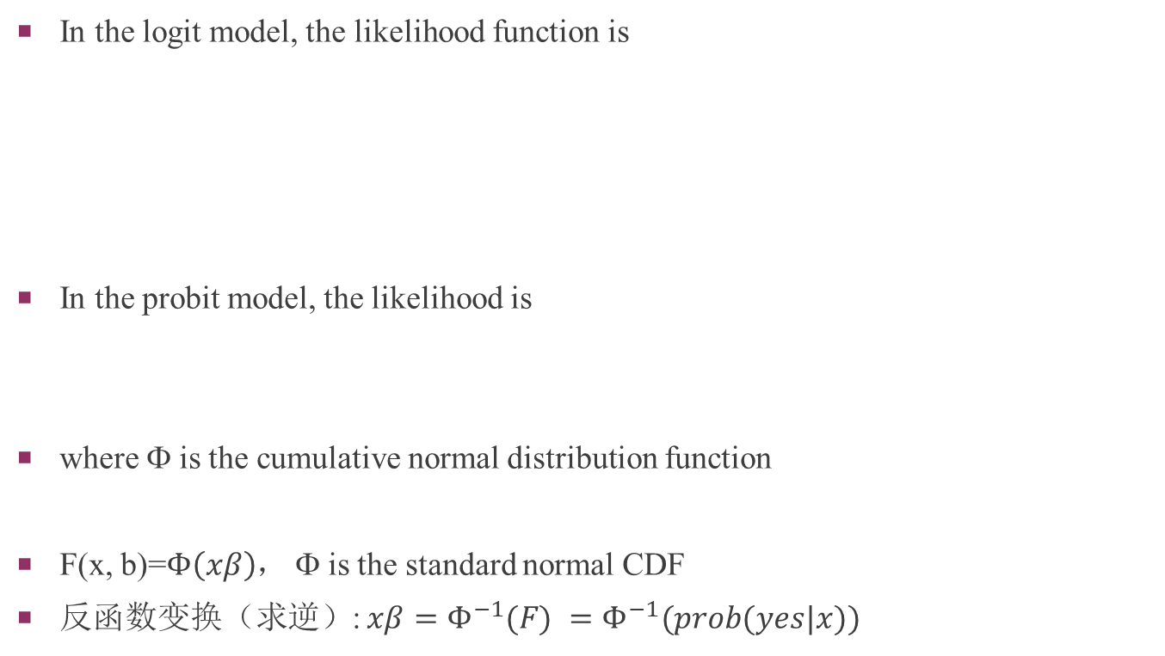
2.3 Binary Choice Model - Probit
In the logit model, the likelihood function is
In the probit model, the likelihood is
where Φ is the cumulative normal distribution function
F(x, b)=$Φ\left(xβ\right)$， Φ is the standard normal CDF
反函数变换（求逆）: $xβ=Φ^{−1}(F) =Φ^{−1}(prob(yes|x))$

Slide 18
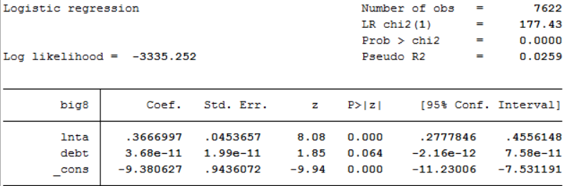
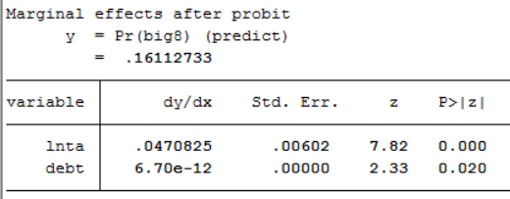
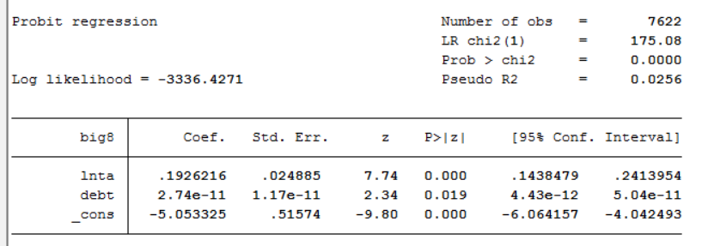
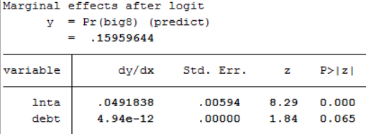
2.3 Binary Choice Model - Probit
Probit vs. logit
Their coefficients are not comparable by specification.
but the partial effect on probability are similar
The levels of statistical significance are often similar

Slide 19
2.3 Binary Choice Model - Probit
Probit vs. logit
The predicted probabilities of probit models are very close to those of logit models
No real reason to prefer one over the other
But there are some difference
Traditionally saw more of the logit, mainly because the logistic function leads to a more easily computed model. Today, probit is easy to compute with standard packages, so more popular
Logistic distribution has heavier tail than normal distribution. For intermediate value of beta*X (say -1.2 to 1.2), both models gave similar probability. But for smaller betaX, logit model tends to give larger probability to y=1. ( smaller probability to y=0).

Slide 20
2.4 Binary Choice Model - comparison
LPM vs. logit (probit)
前面演示过，它们估计出的系数（对概率的边际影响）比较接近
但那是在给定平均观察值时计算的：在LPM中dProb/dx=beta, 而在logit模型中dProb/dx= dProb/dL *beta， dProb/dL的值是在平均观察值（平均x）时计算的，事实上它是x的函数
因此，在Probit (logit) 模型中，x与概率的关系是非线性的
这里x对概率的边际影响依赖于x的取值，并且经常是递减的。
递减的边际影响更符合经济学直观
因此，一般不用LPM
LPM有异方差问题
LPM有拟合值不合理问题
LPM不能产生递减的边际影响

Slide 21
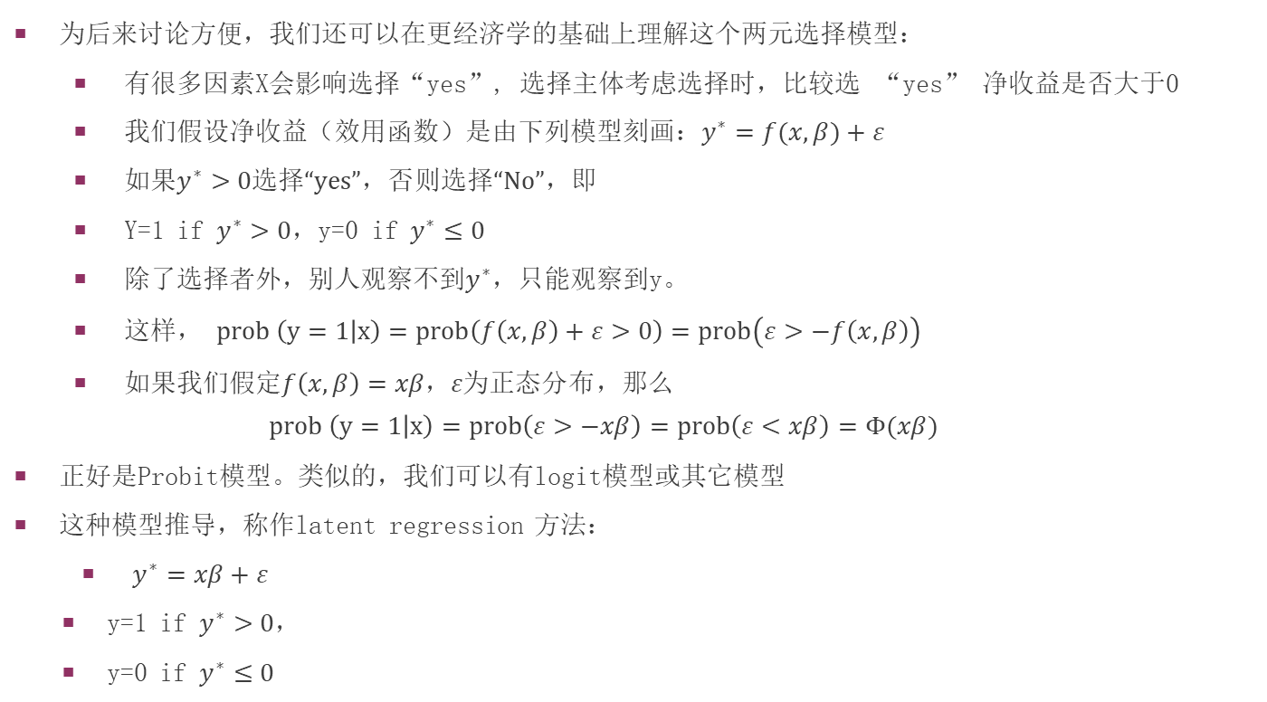
2.5 latent regression
为后来讨论方便，我们还可以在更经济学的基础上理解这个两元选择模型：
有很多因素X会影响选择“yes”, 选择主体考虑选择时，比较选 “yes” 净收益是否大于0
我们假设净收益（效用函数）是由下列模型刻画：$y^{∗}=f(x,β)+ε$
如果$y^{∗}>0选择“yes”，否则选择“No”，即$
Y=1 if $y^{∗}>0$，y=0 if $y^{∗}≤0$
除了选择者外，别人观察不到$y^{∗}$，只能观察到y。
这样， $prob \left(y=1 | x\right)=prob\left(f\left(x,β\right)+ε>0\right)=prob\left(ε>−f\left(x,β\right)\right)$
如果我们假定$f\left(x,β\right)=xβ，ε为正态分布$，那么
$$prob \left(y=1 | x\right)=prob\left(ε>−xβ\right)=prob\left(ε<xβ\right)=Φ(xβ)$$
正好是Probit模型。类似的，我们可以有logit模型或其它模型
这种模型推导，称作latent regression 方法：
$y^{∗}=xβ+ε$
y=1 if $y^{∗}>0$，
y=0 if $y^{∗}≤0$

Slide 22
3 Tobit Model
We often observe that most of the data concentrates on certain numbers, say GPA 89, share of bonus 0.
There are two possible reasons for mess distributed data
Corner solution（角点解）
Utility maximization-based rational choice should give unlimited continuous result, but actually, the outcome is limited
For example, the demand for cigarettes
we do not observe the demand, only the number of cigarettes purchased
the non-smoker may not smoke even if cigarettes were given away for free.
the amount purchased will be zero for all non-smokers
in this case, the data are “left-censored at zero”
Data censoring
Data censoring is top (bottom) coding, i.e., its value only up (down) to a certain threshold
Example: household income survey data
Suppose that respondents are asked their wealth,
but people are allowed to respond with “more than $500,000.”
All these two cases lead to biased OLS estimation.

Slide 23
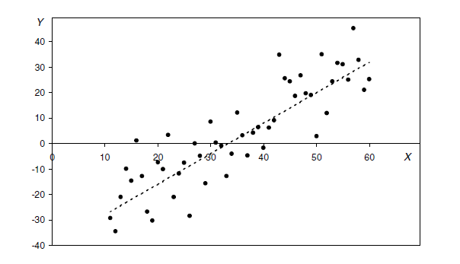
3 Tobit Model
The next two figures clearly show the bias in OLS estimation

Slide 24
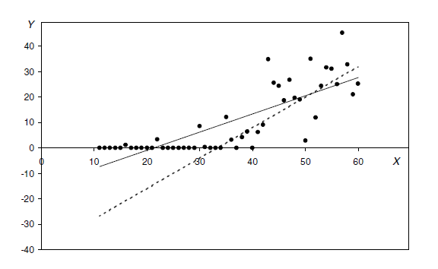
3 Tobit Model
Bias direction?
For lower bounded, to zero
For upper bonded?

Slide 25
3 Tobit Model
The mess observation problem can be solved by estimating a “Tobit” model
the name Tobit refers to an economist, James Tobin, who first proposed the model (Tobin 1958).
Also the idea of“latent regression”model
We assume an linear model for the unobserved continuous variable (Y*)
Y* = a₀+ a₁ X + e
and a mapping between an unobserved continuous variable (Y*) and the observed variable (Y):
Y = 0 if -∞ < Y* ≤ 0
Y = Y* if 0 < Y* < +∞
It is assumed that the uncensored distribution of the dependent variable is normal, and hence errors (e) are normally distributed.

Slide 26

3 Tobit Model
MLE
For censored data
For uncensored data
To put it together
L(y=0)=1 if y=0; L(y=0)=0 otherwise.
For censored data using the first part of the model, and second part for uncensored data.
The usual test (t and Wald) apply.

Slide 27
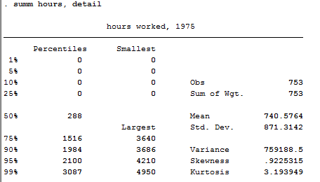
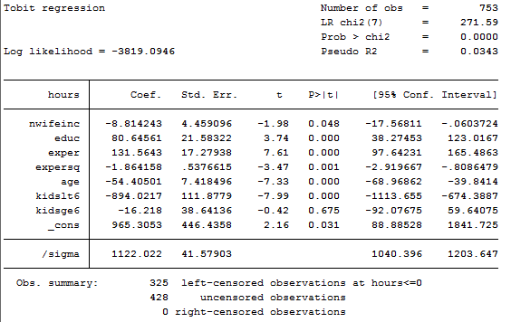
3 Tobit Model
Married women labor supply
use "D:\current_teaching\econometrics_II_2\data\MROZ.DTA", clear
sum hours, detail
tobit hours nwifeinc educ exper expersq age kidslt6 kidsge6, ll(0)
Which line is the result that we estimate using tobit model?

Slide 28
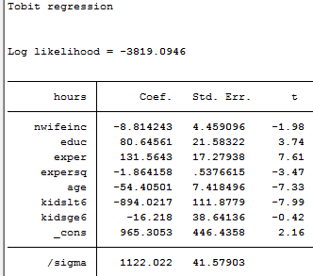
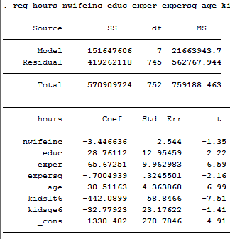
3 Tobit Model
The result of tobit model depicts the dotted line, the y*
Compared with OLS
tobit hours nwifeinc educ exper expersq age kidslt6 kidsge6, ll(0)
reg hours nwifeinc educ exper expersq age kidslt6 kidsge6
All estimates of OLS biased towards zero.

Slide 29

3 Tobit Model
Interpretation of Model
Y* = b₀+ b₁ X + e
Y = 0 if -∞ < Y* ≤ 0
Y = Y* if 0 < Y* < +∞
the marginal effect of x on y*: coefficient b₁
the marginal effect of x on y is
Smaller than b₁ (absolute value）, there the solid line

Slide 30
3 Tobit Model
the marginal effect of x on y given y>0
It is also Smaller than b₁ (absolute value）, there the solid line
Why does not it equal b1 ?Because when y>0, y equals y*？
Even if y=y* under the condition that y>0, b₁ is the average effect of x on all y*, but the estimate here is the effect of x on y* >0
Which is the one that we cares about?
Pure data censoring： effect of x on y*:
Corner solution： effect of x on y given y>0

Slide 31
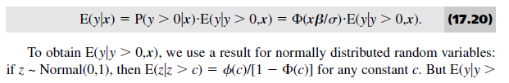
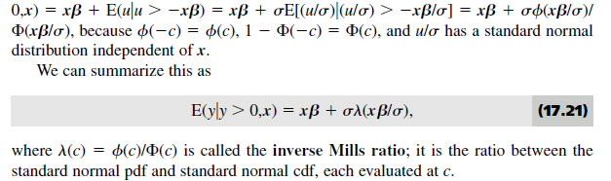
3 Tobit Model

Slide 32

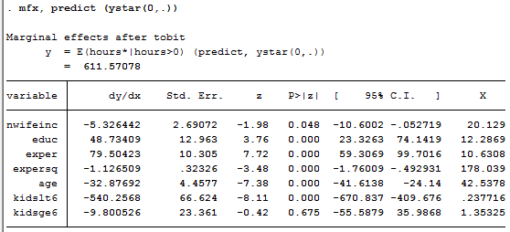
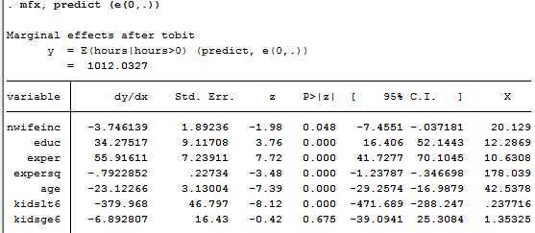
3 Tobit Model
Stata
tobit hours nwifeinc educ exper expersq age kidslt6 kidsge6, ll(0)
The marginal effect of x on y|y>0?
mfx, predict (ystar(0,.))
Smaller than beta！
The marginal effect of x on y?
mfx, predict (e(0,.))
Also smaller than beta
Compared with OLS与OLS回归的比较
reg hours nwifeinc educ exper expersq age kidslt6 kidsge6
Similar to the marginal effect of x on y

Slide 33
3 Tobit Model
Tobit vs. OLS
OLS gets biased results
OLS does not estimate the impact of x on y*
The option ll() specifies the lower limit at which the dependent variable is left-censored
For example, non-audit fees are left-censored at zero, so we type ll(0)
The option ul() specifies the upper limit at which the dependent variable is right-censored
It can also estimate the data being both left-censored and right-censored
tobit y x1 x2, ll(a) ul(b)

Slide 34
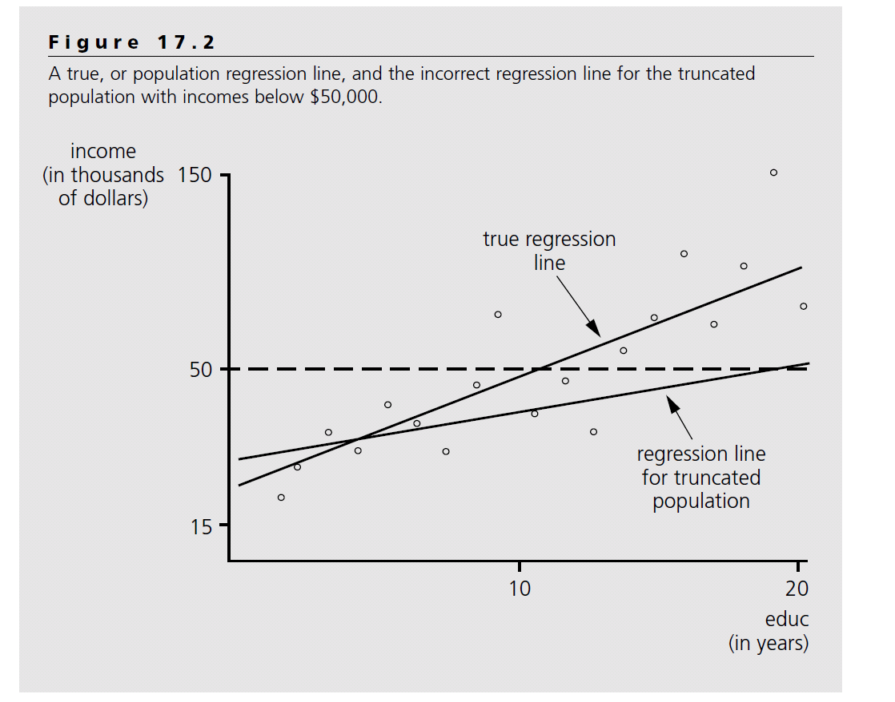
4 Truncated Regression Model
Unlike the data in tobit model, if the affected data are deleted from the observed sample, the tobit model does not work in this case.
Following the idea of latent regression, the question can be rewritten as：
y = xb + u, u|x,c ~ Normal(0,s²), but we only observe those y when y<c (or y>c if lower limit truncated)
Obviously, the OLS gives biased results.
Towards?;
Intuitively, toward zero.
But is it?

Slide 35

4 Truncated Regression Model
model： y = xb + u, u|x ~ Normal(0,s²), but we only observe those y when y>a
The marginal effect of x on y：$\frac{∂E(y|x)}{∂x}=β$
When y>0, the marginal effect of x on y ：
GMM estimates.
The function λ(α) is called the inverse Mills ratio
Therefore：

Slide 36

4 Truncated Regression Model
Model： y = xb + u, u|x ~ Normal(0,s²), but we only observe those y when y>a
The marginal effect of x on y ：$\frac{∂E(y|x)}{∂x}=β$
OLS estimates:
Obviously, biased towards 0
Since $E\left(y | x,y>a\right)=xβ+σλ(a)$, we can estimate the model just like the LPM
$y=xβ+σλ\left(a\right)+ε，given y>a$,
Use OLS estimate the model with$λ\left(a\right)$？
No，b$ecasue λ\left(a\right) is a function of beta$
We can estimate the model using MLE

Slide 37
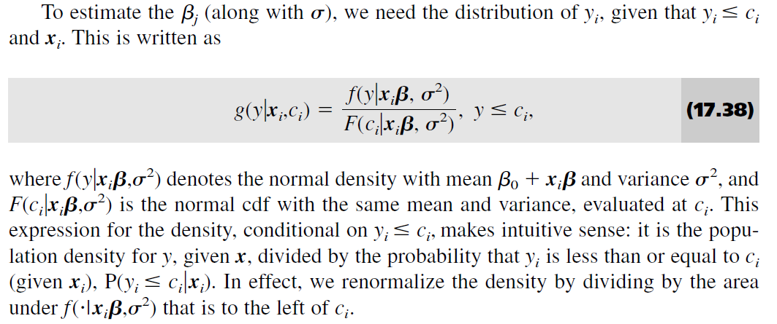
4 Truncated Regression Model
MLE
Unlike censoring, we do not know how many observations are truncated！
But we can show the distribution of observed data：

Slide 38
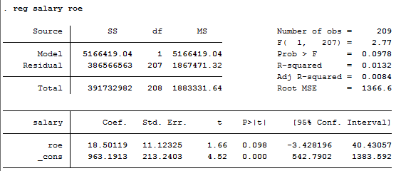
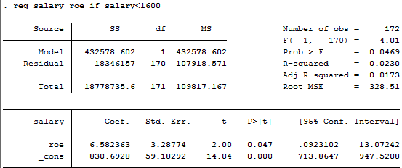
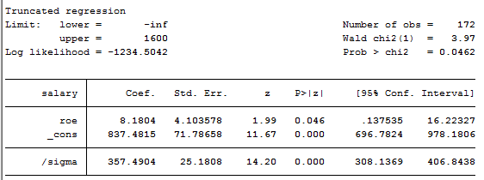
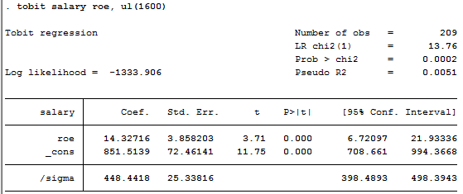
4 Truncated Regression Model
Example: CEO salary and firm performance
reg salary roe // baseline model
If the data is truncated at 1600, and we still use OLS
reg salary roe if salary<1600
Underestimate
Using truncated model at 1600
truncreg salary roe, ul(1600)
The estimate is more accurate than ols
V.S. Tobit
tobit salary roe, ul(1600)

Slide 39
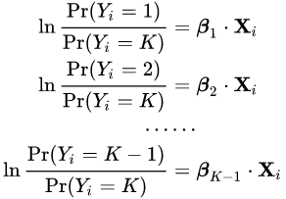
5 Multinomial logit model
Multinomial logistic regression is a model that is used to predict the probabilities of the different possible outcomes of a categorically distributed dependent variable, given a set of independent variables.
Multiple logistic regression analyses, one for each pair of outcomes: One problem with this approach is that each analysis is potentially run on a different sample. The other problem is that without constraining the logistic models, we can end up with the probability of choosing all possible outcome categories greater than 1.

Slide 40
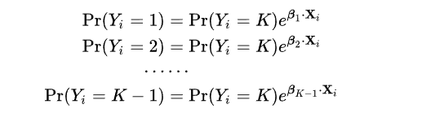
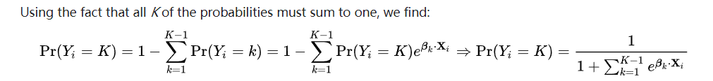
5 Multinomial logit model
This formulation is also known as the alr transform commonly used in compositional data analysis. Note that we have introduced separate sets of regression coefficients, one for each possible outcome.
If we exponentiate both sides, and solve for the probabilities, we get:

Slide 41
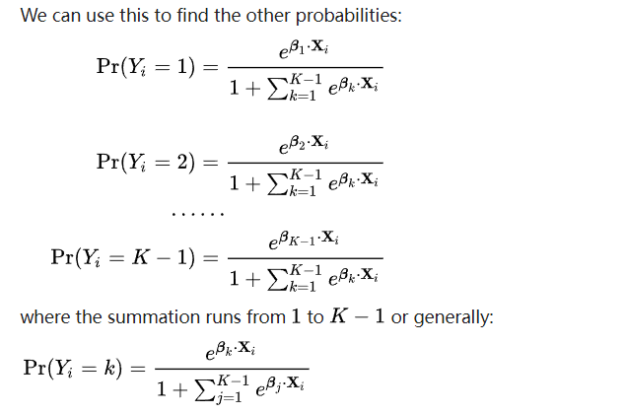
5 Multinomial logit model

Slide 42
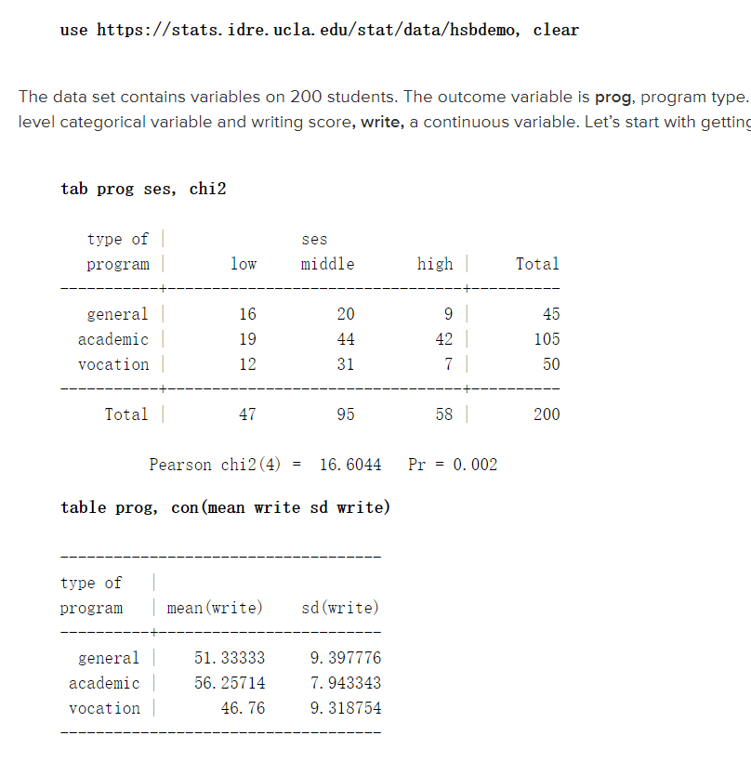
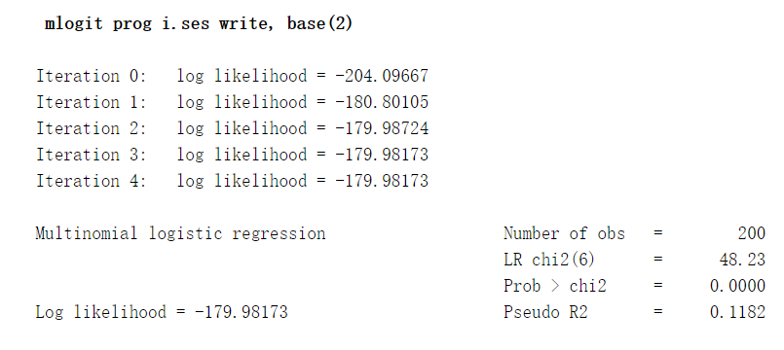
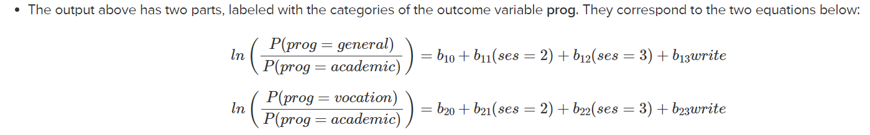
5 Multinomial logit model

Slide 43
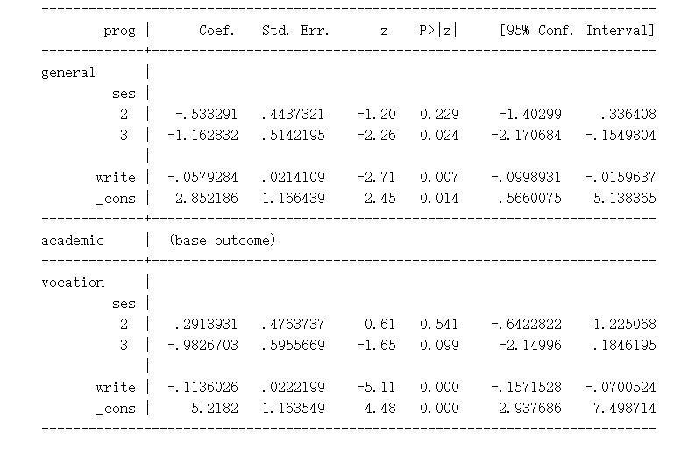
5 Multinomial logit model
A one-unit increase in the variable write is associated with a .058 decrease in the relative log odds of being in general program vs. academic program .
A one-unit increase in the variable write is associated with a .1136 decrease in the relative log odds of being in vocation program vs. academic program.
The relative log odds of being in general program vs. in academic program will decrease by 1.163 if moving from the lowest level of ses (ses==1) to the highest level of ses (ses==3).

Slide 44
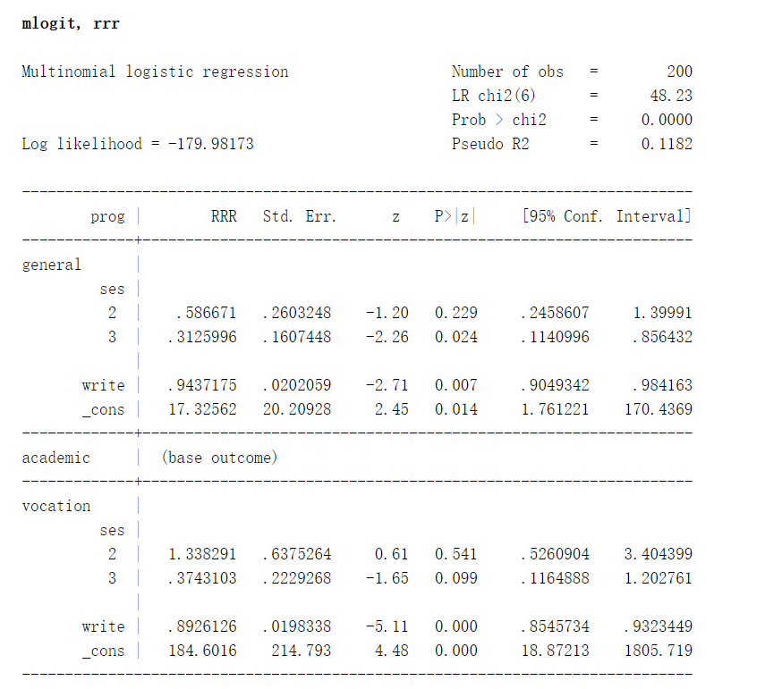
5 Multinomial logit model
The ratio of the probability of choosing one outcome category over the probability of choosing the baseline category is often referred to as relative risk (and it is also sometimes referred to as odds as we have just used to described the regression parameters above). Relative risk can be obtained by exponentiating the linear equations above, yielding regression coefficients that are relative risk ratios for a unit change in the predictor variable. We can use the rrr option for mlogit command to display the regression results in terms of relative risk ratios.
The relative risk ratio for a one-unit increase in the variable write is .9437 (exp(-.0579284) from the output of the first mlogit command above) for being in general program vs. academic program.
The relative risk ratio switching from ses = 1 to 3 is .3126 for being in general program vs. academic program. In other words, the expected risk of staying in the general program is lower for subjects who are high in ses.

Slide 45
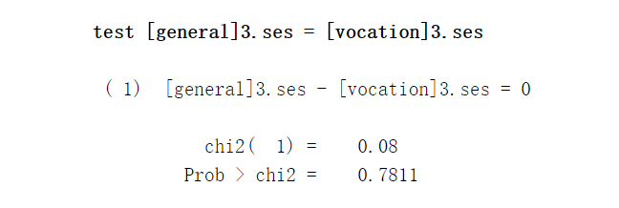
5 Multinomial logit model

Slide 46
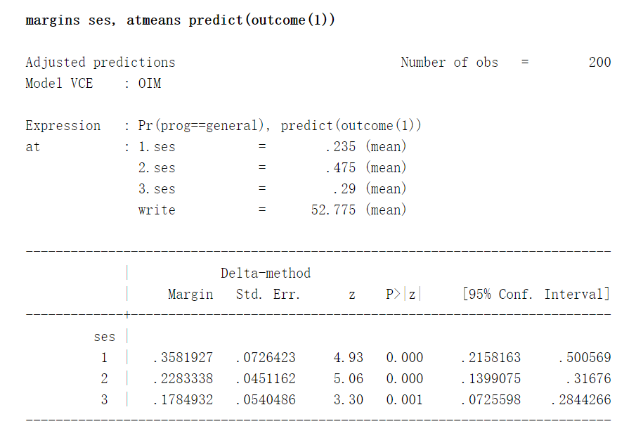

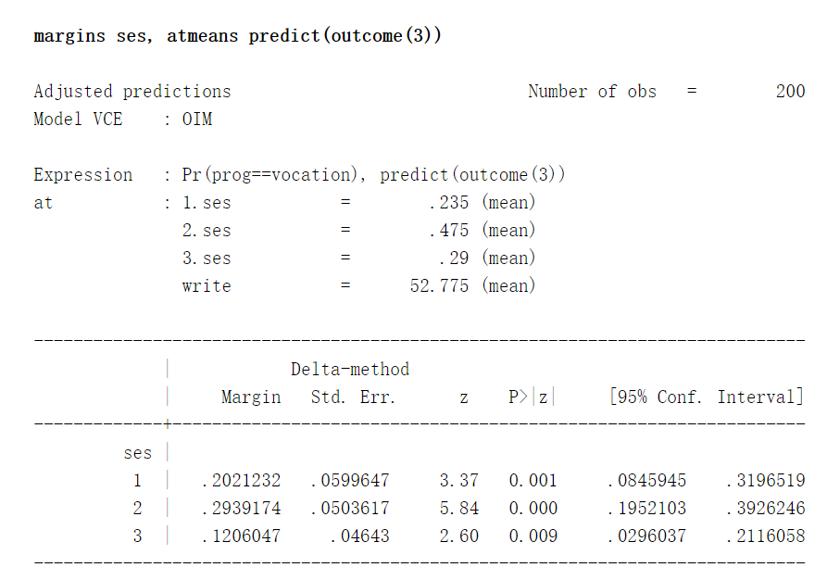
5 Multinomial logit model
You can calculate predicted probabilities using the margins command. Below we use the margins command to calculate the predicted probability of choosing each program type at each level of ses, holding all other variables in the model at their means. Since there are three possible outcomes, we will need to use the margins command three times, one for each outcome value.

Slide 47
6 Endogeneity problem
Much more complicated than the OLS estimates, and we just introduce the basic three settings
Y is a dummy variable, and x is a continuous variable
Y is a continuous variable, and x is a dummy variable
Both Y and X are dummy variables

